Slide 1
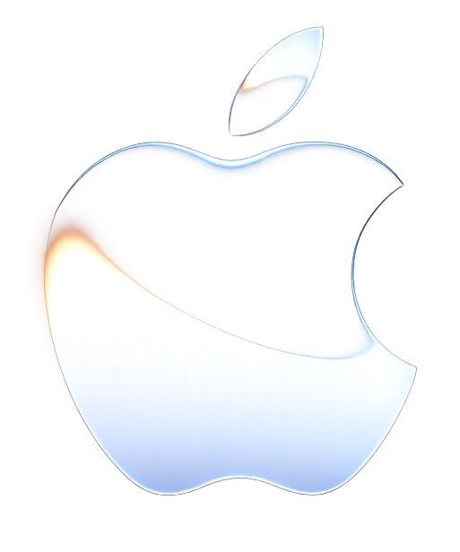

Apple WWDC26
All Systems Glow – Jun 8-12
Apple's premier annual event shaping the future of software, AI, and developer innovation.

Slide 2
What is WWDC?
Annual Apple event
WWDC (Worldwide Developers Conference) is Apple's premier event for developers, designers, and technology enthusiasts. It showcases upcoming software updates, new development frameworks, and emerging technologies across Apple platforms.
Software-focused conference
Global developer participation
Technology and innovation showcase

Slide 3

Why WWDC Matters
WWDC plays a crucial role in defining Apple's technology roadmap and enabling developers to build next-generation applications.
Early access to new technologies
Developer education and training
Innovation across Apple platforms
Industry-leading software announcements

Slide 4






Software Innovations
User Experience
Security
WWDC introduces major software enhancements that improve performance, security, productivity, and usability.
Performance
Accessibility
Productivity Tools

Slide 5
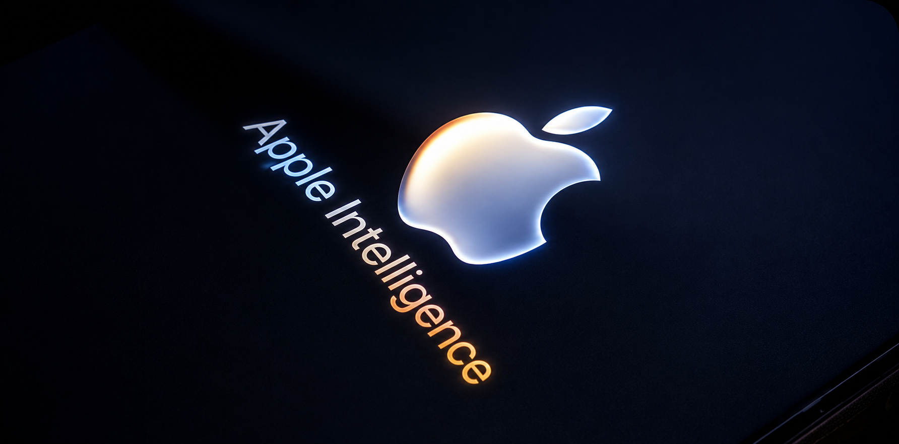
Apple Intelligence & AI
Smart Writing Assistance
Intelligent Recommendations
Content Summarization
Context-Aware Actions
Personalized User Experiences
Artificial Intelligence is becoming a key part of Apple's ecosystem, helping users work smarter and more efficiently.
The goal is to help users work faster while maintaining privacy and security.

Slide 6
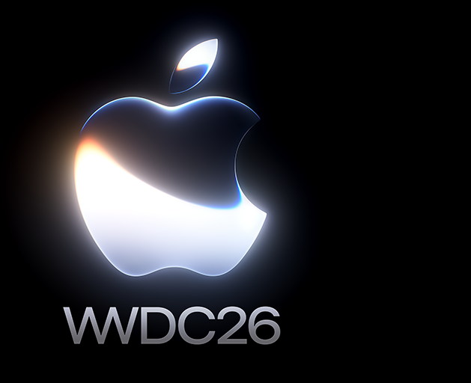
Software Platform Updates
WWDC26 introduces advancements across Apple's operating systems.
Platforms
iOS
watchOS
Improvements
iPadOS
tvOS
Better Performance
Enhanced Security
Improved User Interface
AI-Powered Features
macOS
visionOS

Slide 7
Siri Evolution
From Voice Assistant to Intelligent Companion
2011
2021
2026
Siri Launch
On-Device AI
Siri Evolution
Voice commands introduced on iPhone.
Faster responses with better privacy.
More natural and conversational AI.
App Integration
Apple Intelligence
Intelligent Assistant
Connected with third-party apps.
Smarter, context-aware assistance.
Personalized, proactive experiences.
2016
2024
Future

Slide 8
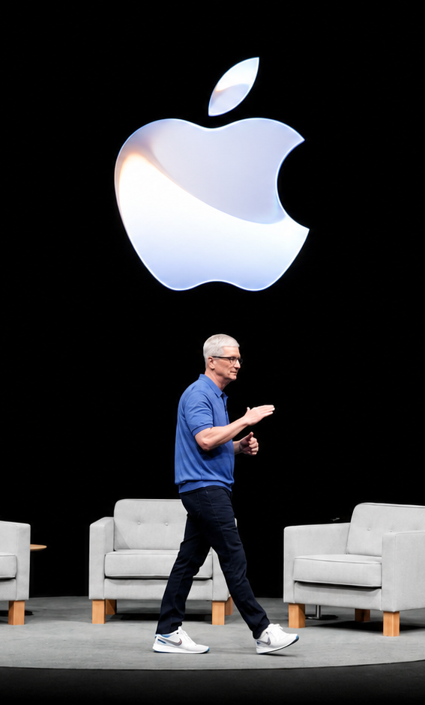
Empowering Developers
WWDC26 introduces new technologies that help developers create powerful applications.
Updated Xcode
Swift Enhancements
New
APIs
Machine Learning Tools
Advanced Frameworks

Slide 9
Connected Apple Ecosystem
Impact of WWDC26
For Consumers
Smarter Devices
Enhanced Productivity
Improved Security
Personalized Experiences
Apple continues to strengthen integration across its devices.
Benefits
Seamless Device Connectivity
Shared Experiences
Improved Productivity
Better Collaboration
Unified Ecosystem
Users can move effortlessly between devices while maintaining continuity.
For Businesses
Innovation Opportunities
Better Customer Engagement
Advanced App Experiences

Slide 10
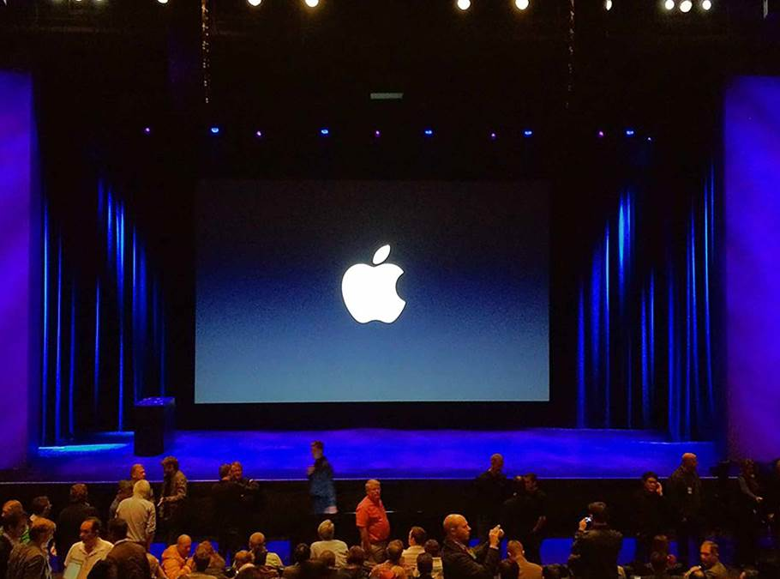
The Future Ahead
WWDC26 demonstrates Apple's commitment to innovation through artificial intelligence, software excellence, and developer empowerment.
Key Takeaways
✓ Apple Intelligence
✓ Software Innovation
✓ Smarter Siri
✓ Developer Growth
✓ Ecosystem Integration

Slide 11
Icons

Slide 12
Icons

Slide 13
Educational Icons
Medical Icons

Slide 14
Help & Support Icons
Teamwork Icons

Slide 15
How To Edit Shapes
You can add and edit some shapes to your presentation to present your data in a visual way.
Choose your favourite infographic and insert it in your presentation using Ctrl C + Ctrl V or Cmd C + Cmd V in Mac.
Select one of the parts and ungroup it by right-clicking and choosing “Ungroup”.
Change the color by clicking on the paint bucket.
Then resize the element by clicking and dragging one of the square-shaped points of its bounding box (the cursor should look like a double-headed arrow). Remember to hold Shift while dragging to keep the proportions.
Group the elements again by selecting them, right-clicking and choosing “Group”.
Repeat the steps above with the other parts and when you’re done editing, copy the end result and paste it into your presentation.
Remember to choose the “Keep source formatting” option so that it keeps the design. For more info, please visit Slideegg (Tips & Tricks).

Slide 16
Terms of Use – Free & Premium Users
Free Users
Must retain the “Thank You” slide to credit SlideEgg
Allowed to customize and edit the template
Can use for business and personal purposes
Premium Users
No attribution required (can remove “Thank You” slide)
Full rights to customize, edit, and share the editable file
Suitable for business and personal use
Permitted Usage (All Users)
Modify and personalize the template
Use in presentations, reports, and projects
Note
Refer to the Tutorial / FAQ section for advanced editing guidance.
Restrictions (All Users)
Cannot sell, rent, or re-license the template
Cannot redistribute or publish as a standalone product
Cannot include in any database or resale platform
Cannot claim copyright or ownership
Cannot extract and reuse individual design elements (logos, icons)

Slide 17






Thank You!
We respect your valuable time with SlideEgg!
If you have any questions, please reach us
Do you have a design request, please visit our Deckez site.
CREDIT: SlideEgg created this PowerPoint template.
Let this slide be kept for attribution.
www.slideegg.com

